Slide 1



Powerline parameter monitoring via IOT
Project Guide- Dr. R.B. Ghongade
Project by- Kanak Kharbanda, Anchal Gupta,Sushant Garg

Slide 2


Literature survey
Grid: 1.Traditional Grid
2. Smart Grid: a)GSM
b) 3G
c)Optical Fiber

Slide 3

OBJECTIVE

Slide 4

1)Continuous line voltage, load current, kWh, Power factor and line frequency acquisition
2) Display on LCD
3) Parameter transmission via WI-FI using MQTT
4) Front end GUI on Laptop/ Android device

Slide 5


Slide 6
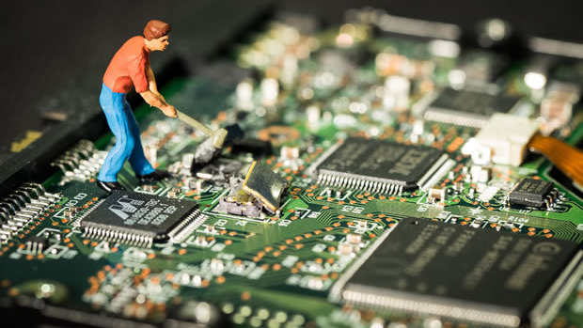
There are 5 hardware used for this project
PZEM004T
ESP 32
LCD 20X4
RTC Module DS3231
LCD I2C

Slide 7
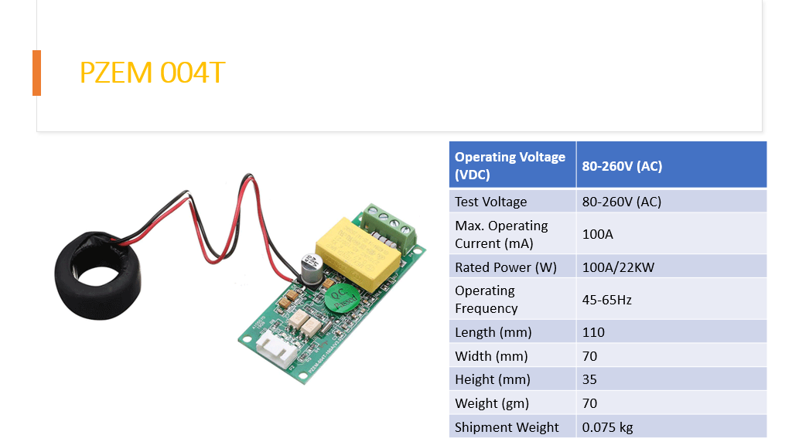

Slide 8
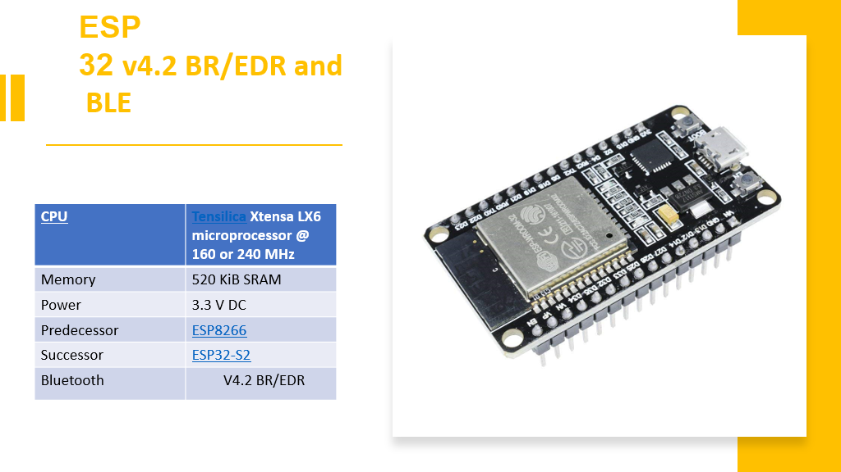

Slide 9
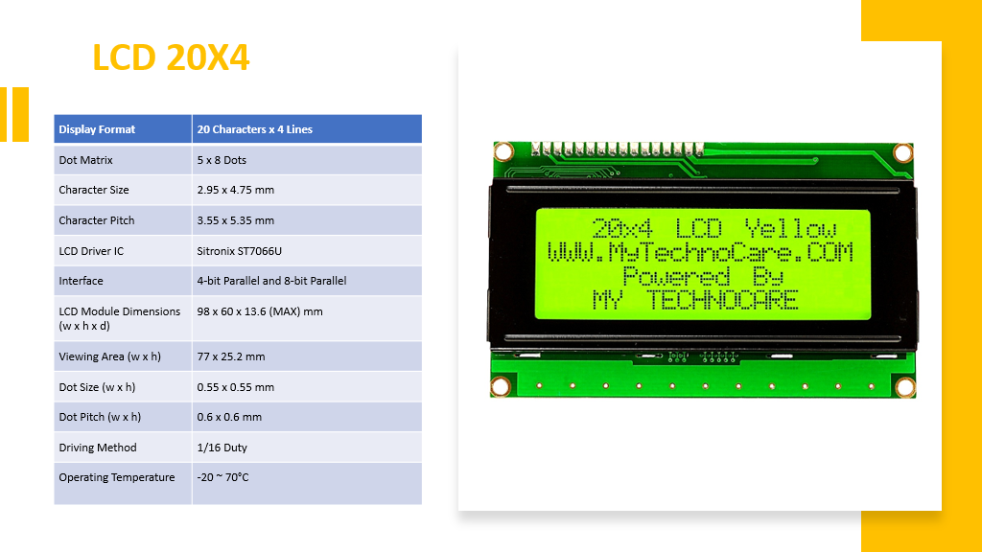

Slide 10
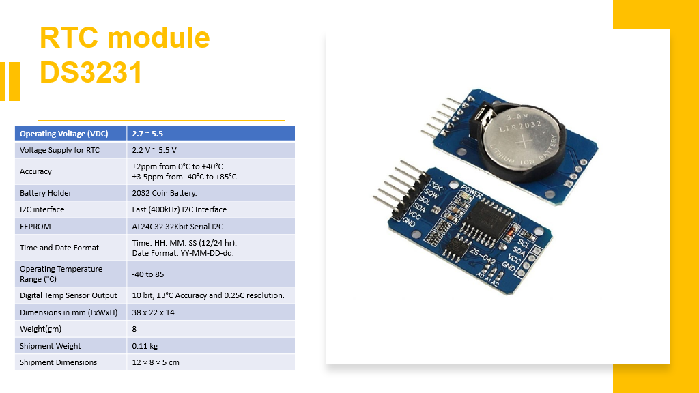

Slide 11
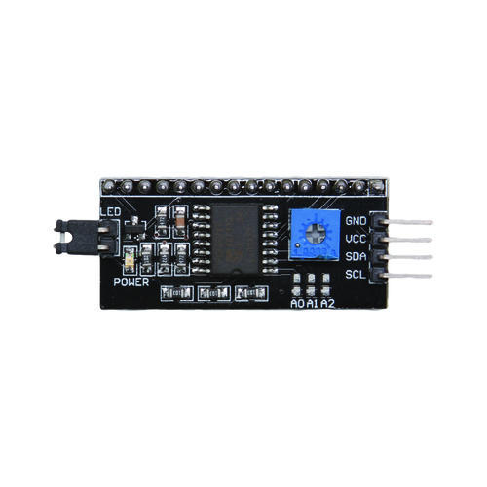
LCD i2C
Parameter | Value
Screen Type | Dual colour LCD
Screen Resolution | 128*64 Pixels
Screen Active Area (L*W) | 47.1*26.5mm
Individual Pixel Size | 0.33*0.33mm
Communication Mode | I2C(100Kbit/s and 400Kbit/s)
Controller | STM8S005KBT6
Operating Frequency | 16 MHz
Weight | 20g

Slide 12

Difference between us and other similar devices.
The use of MQTT Protocol makes us different because it allows us to complete our objective of real time communication with the device.

Slide 13

How does MQTT makes us advance than current technology?

Slide 14
MQTT is
light weight
real time
cost effective
less complex
energy efficient
most suited for short distance communication
Allows monitoring on smart devices like phones in real time.

Slide 15

Total work done till now

Slide 16
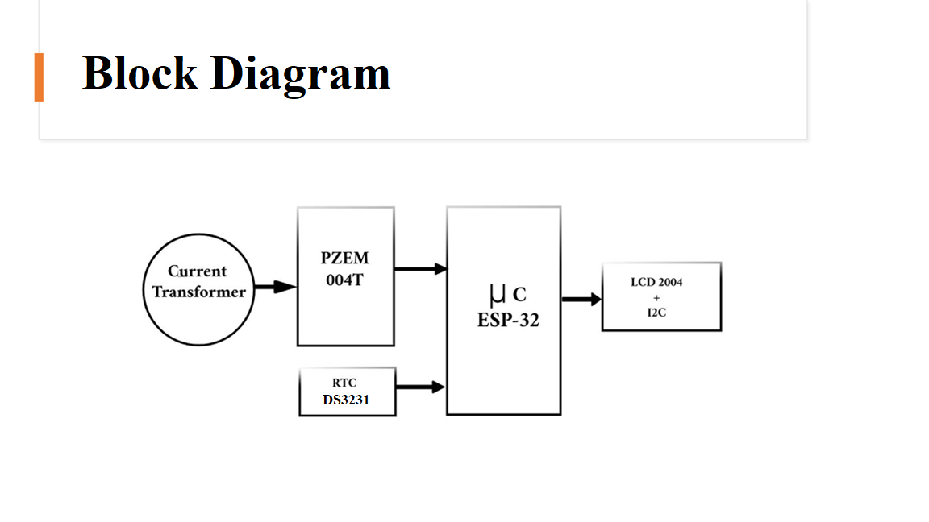

Slide 17

Schematic Diagram

Slide 18
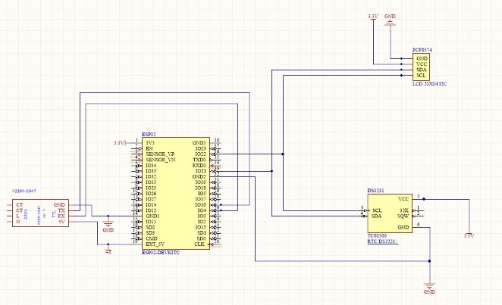
Schematic diagram

Slide 19
PCB Layout

Slide 20
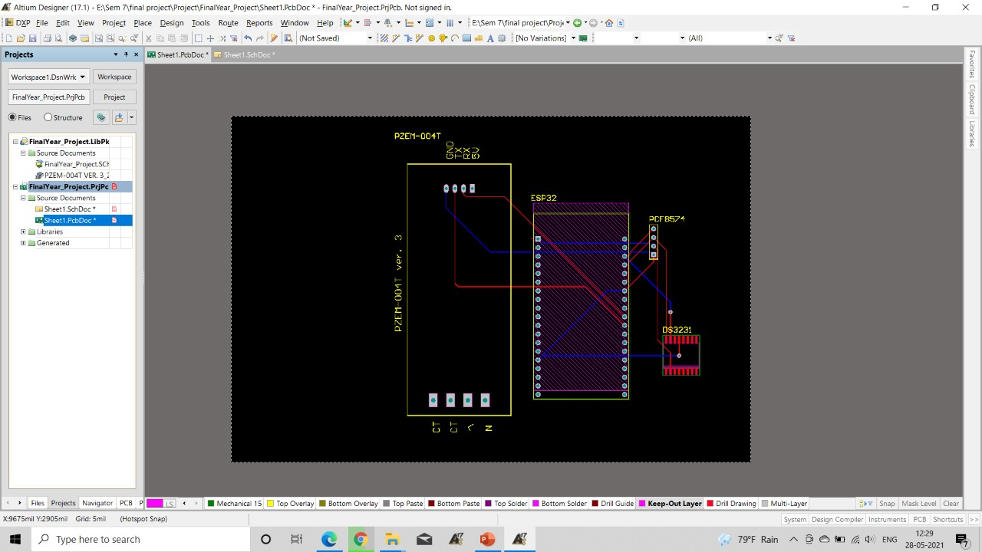

Slide 21
LCD Output

Slide 22
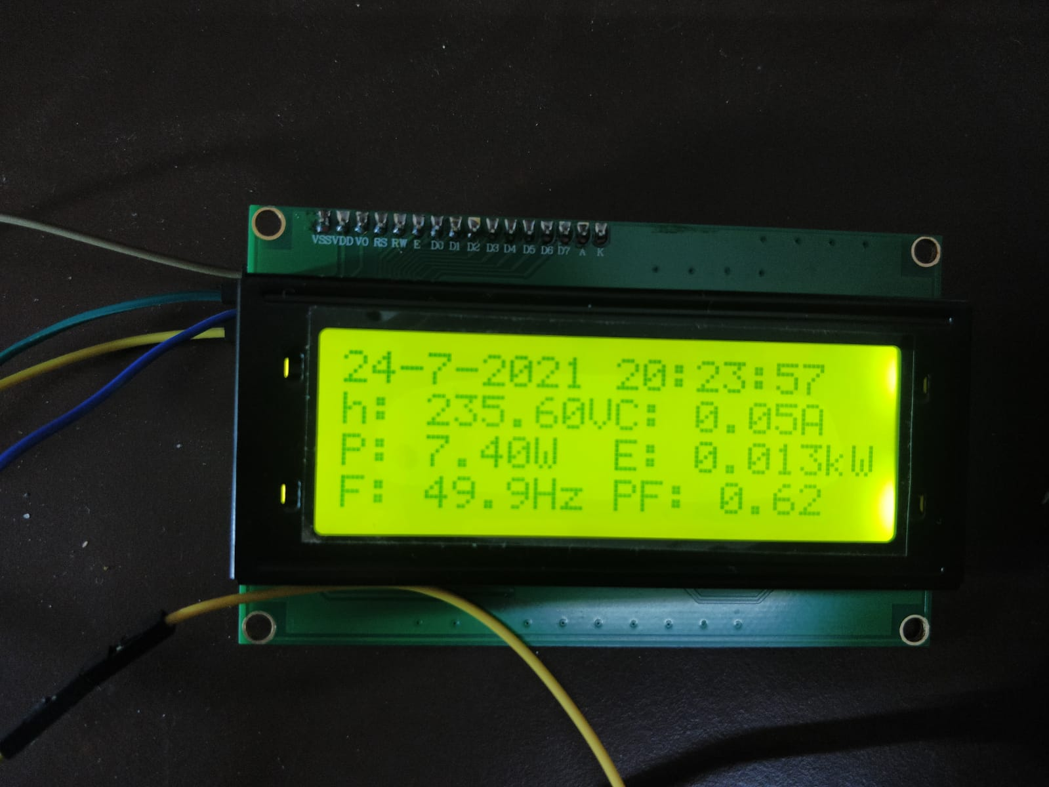

Slide 23
Software UI

Slide 24
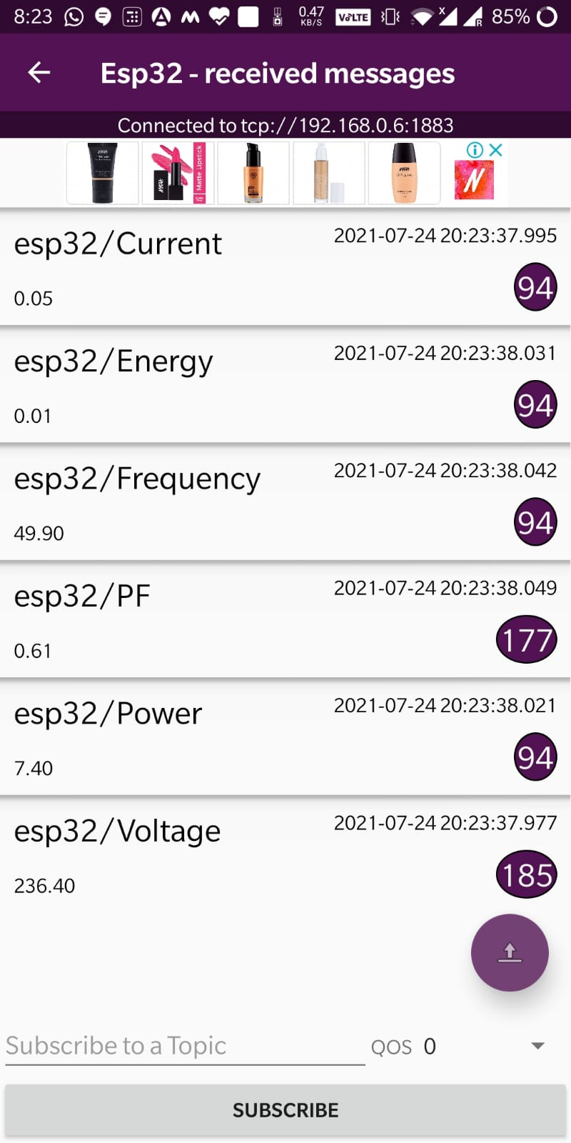

Slide 25
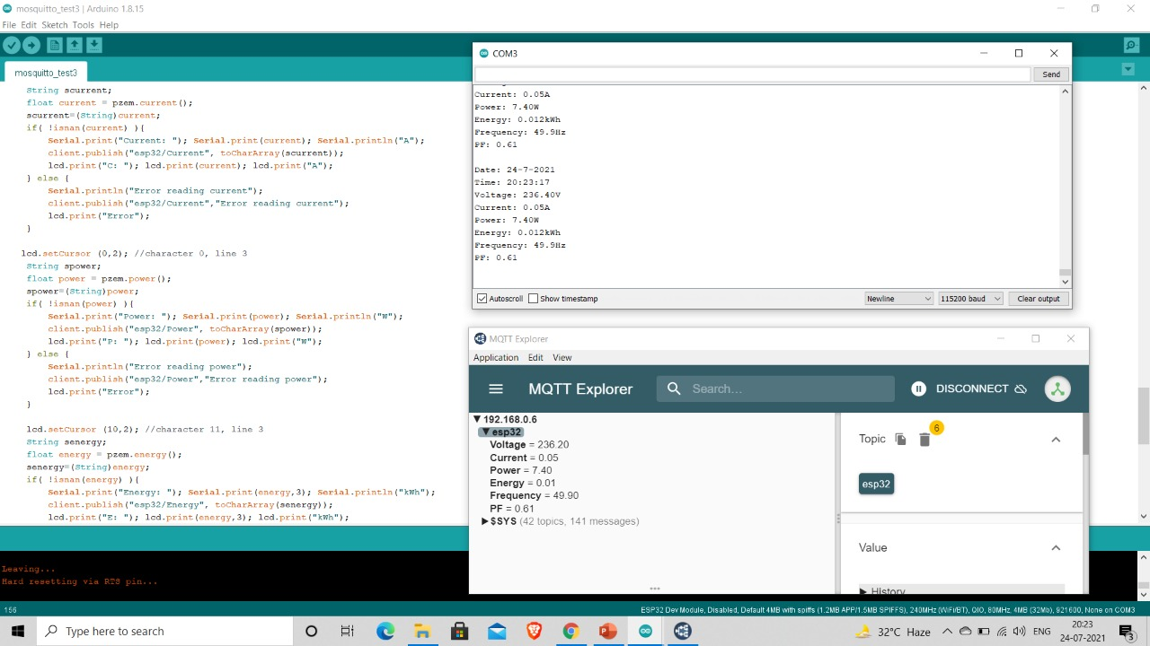

Slide 26
Video of working Model

Slide 27
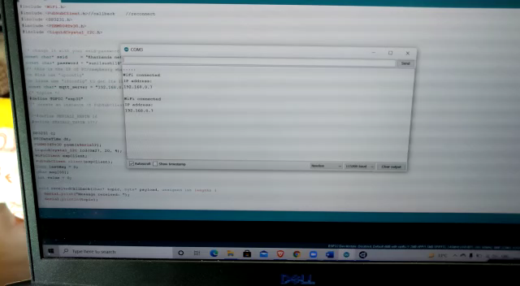

Slide 28

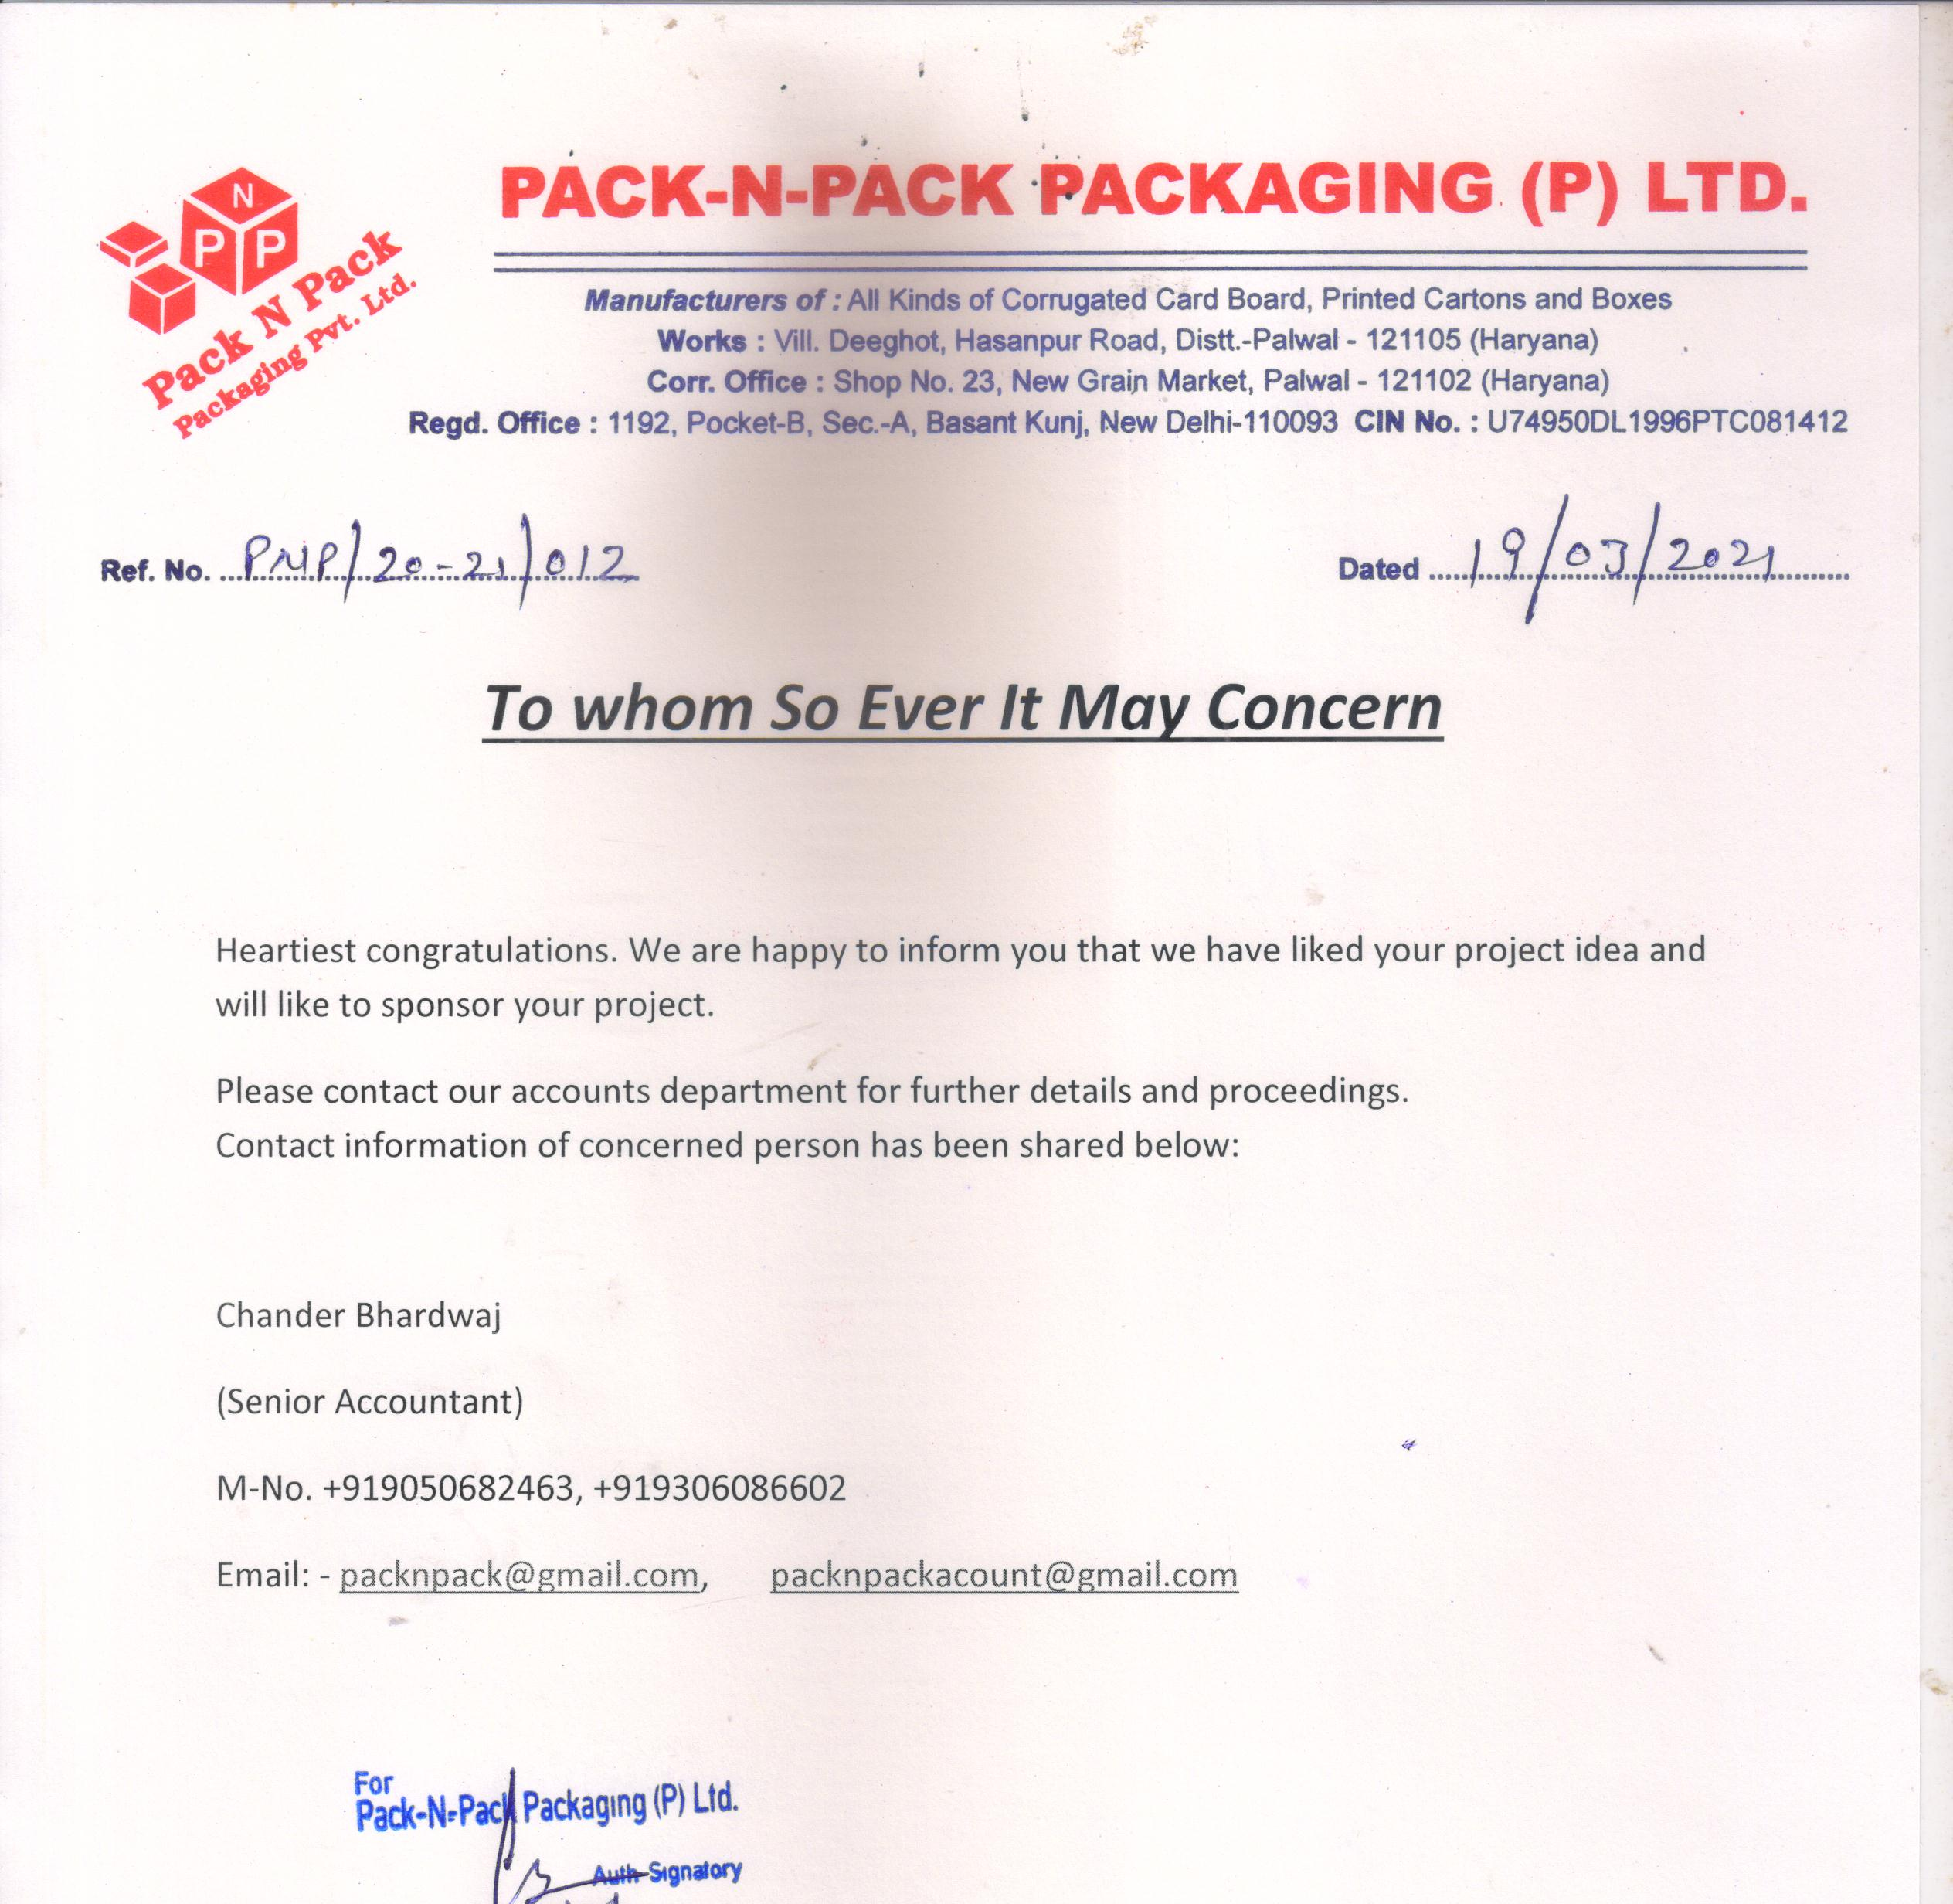
Our sponsor
Pack and Pack Packaging (P) Ltd.

Slide 29

That would be all!!
Thank you

